Slide 1



Microsoft Power Apps
CIS 5610: Design of E-Commerce Site
Instructor: Prof. Susan Khoee
Presented by:
Snehil Sarkar
Sapan Shah

Slide 2

Objectives
Introduction
Microsoft power platform ecosystem
Overview of creating apps in power apps
Microsoft Power app features
Differences between power apps and traditional app development approaches
Planning a power app project
Use Cases
Customers using power apps
Advantages & Limitations
Future scope

Slide 3
Introduction
Low code rapid application development environment.
Power app is a suite of apps, services, and connectors, as well as a data platform, to build custom apps for our business needs.
Apps built using power apps provide rich business logic and workflow capabilities to transform your manual business operations into digital, automated processes.
Developed apps can run seamlessly in browsers and on mobile devices (phone or tablet).
Also provides an extensible platform that lets pro developers programmatically interact with data and metadata, apply business logic, create custom connectors, and integrate with external data.

Slide 4

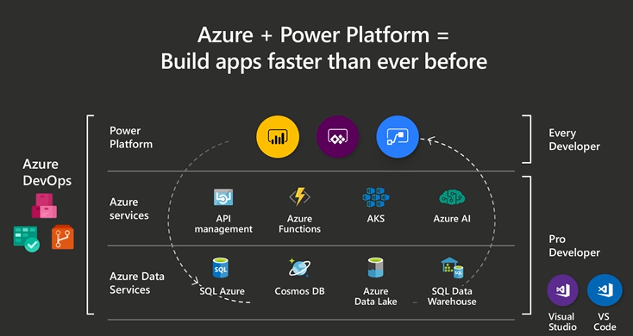



Microsoft Power Platforms Ecosystem

Slide 5
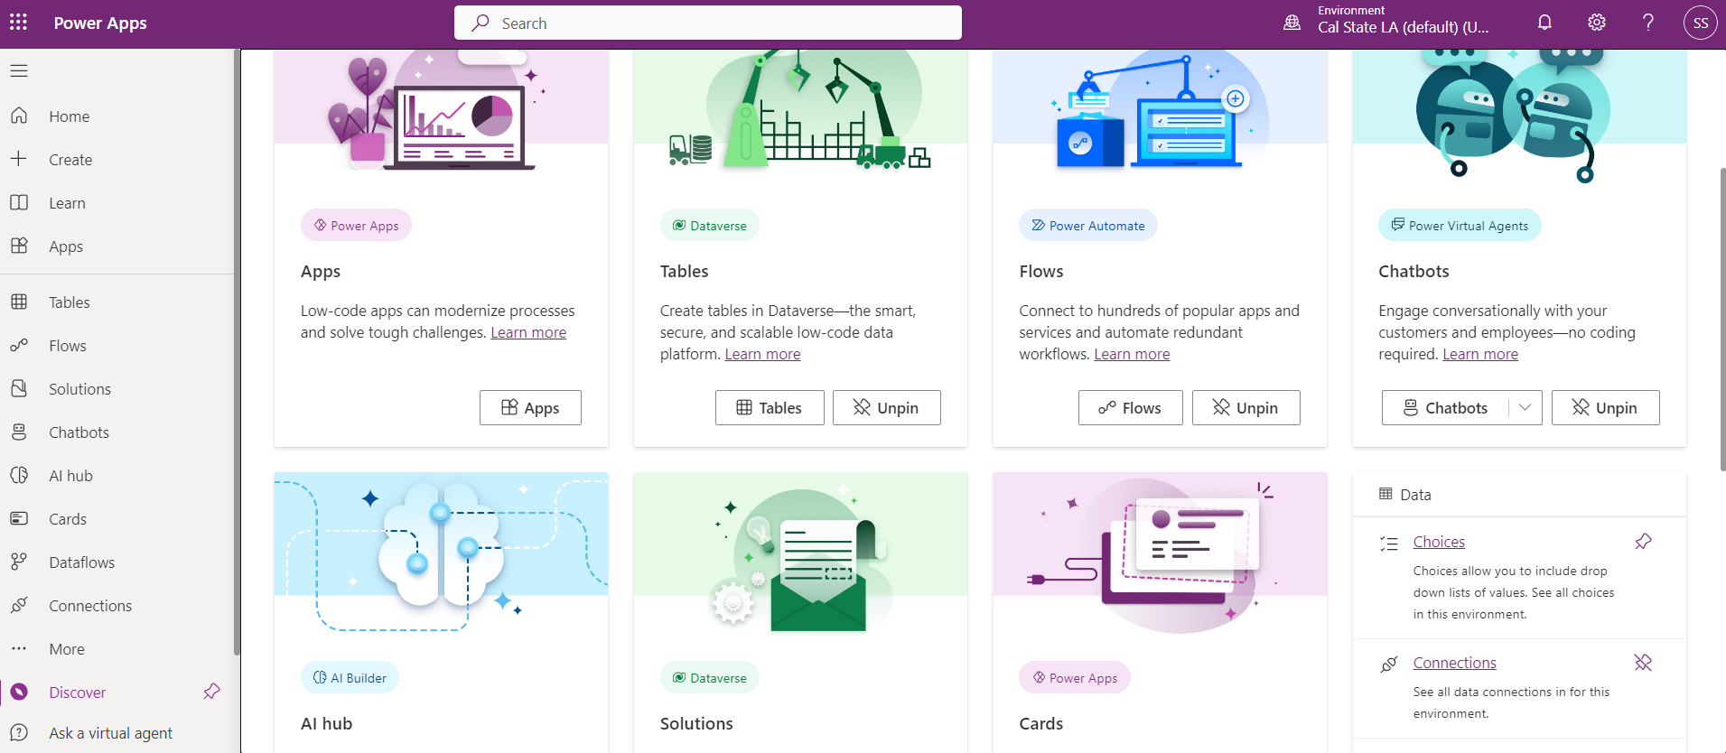
Overview of Creating Apps in Power Apps
Power Apps is a high-productivity development platform for making business apps, and has four major components:
Canvas apps: Design the app by dragging and dropping elements onto a canvas.
Model-driven apps: Especially well suited to process-driven apps that are data-dense.
Cards: Micro-apps with enterprise data and workflows and interactive, lightweight UI elements that other applications can use as content.
Microsoft Dataverse: Data backbone that enables people to store their data in a scalable and secure environment dynamically. Data within Dataverse is stored within a set of tables.

Slide 6
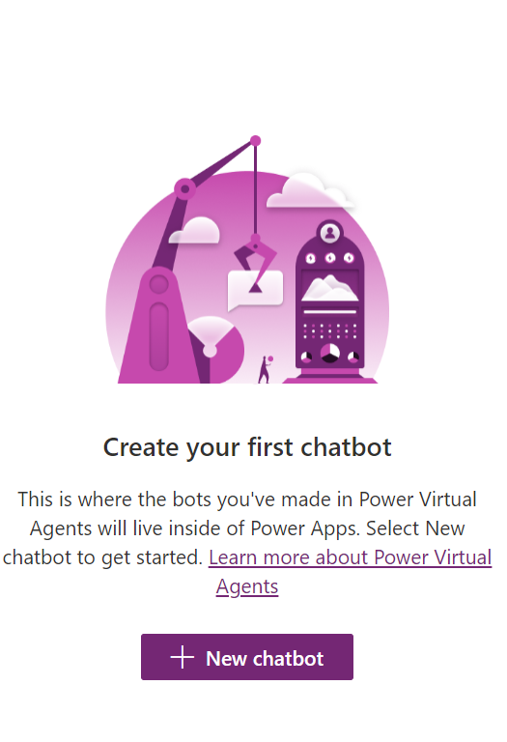
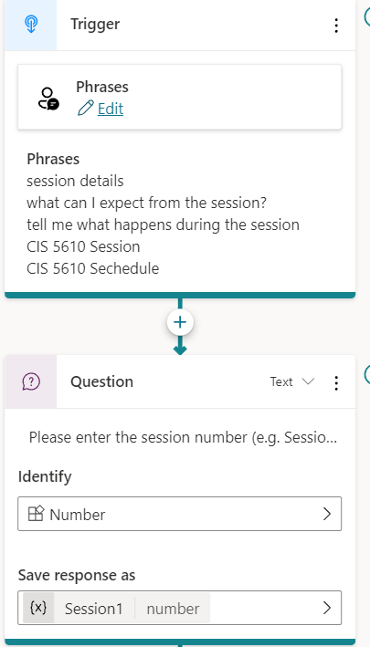
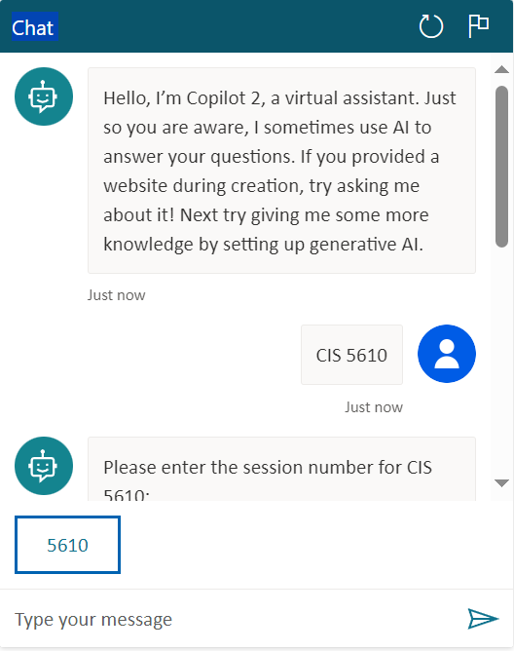
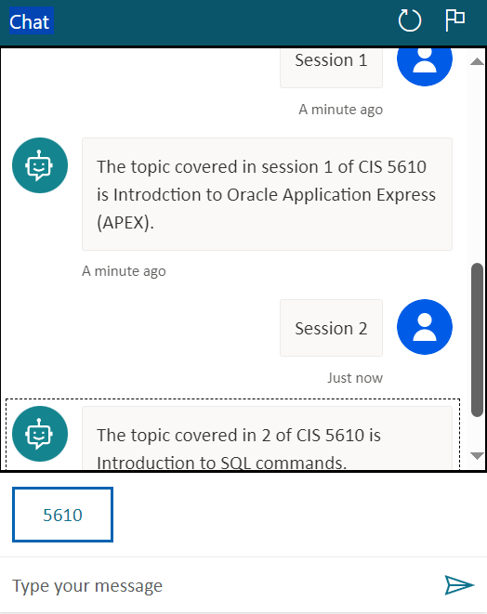
Sample Chatbot

Slide 7
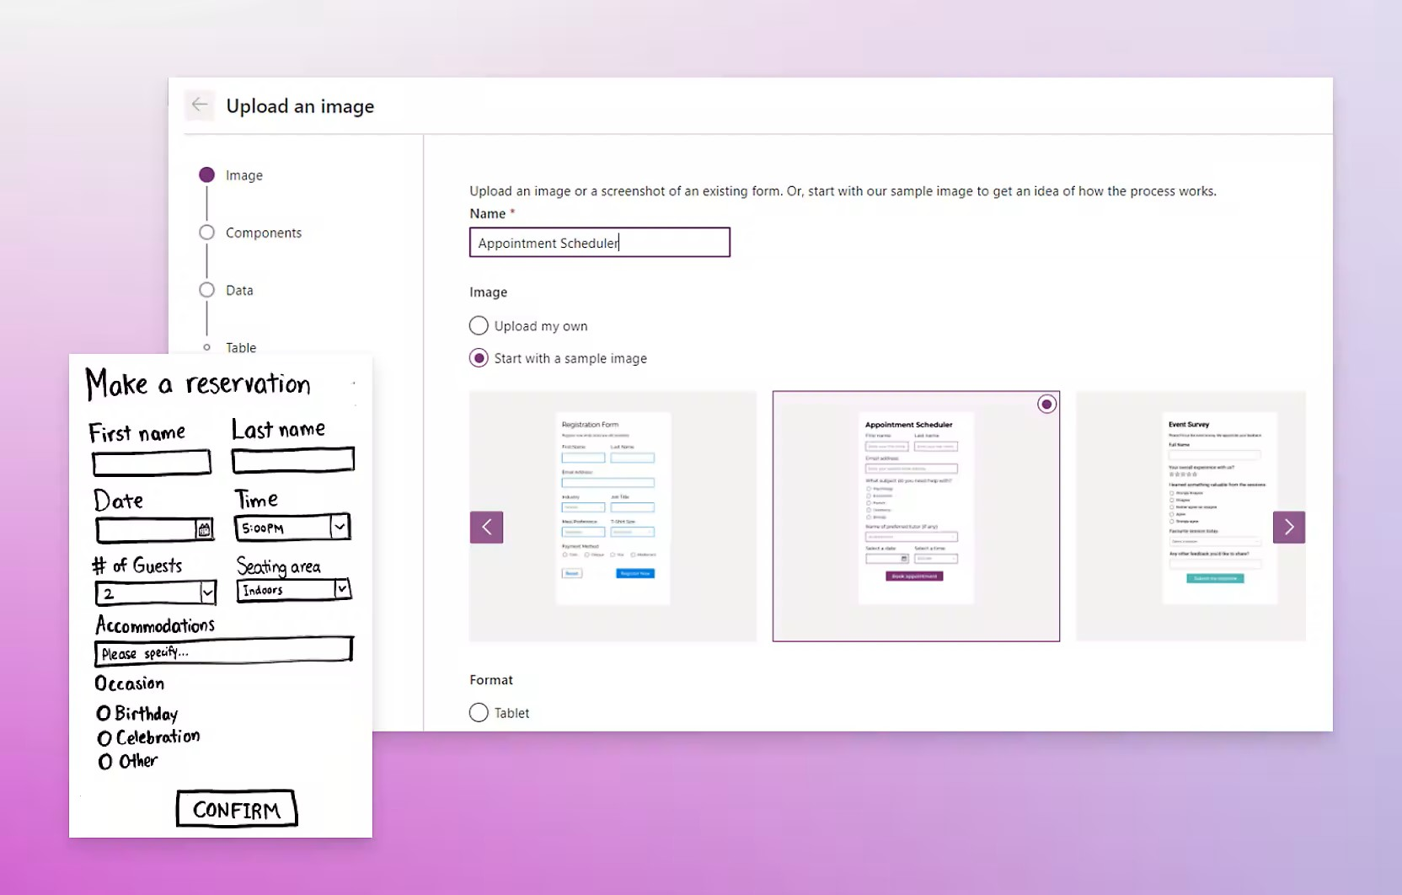
Microsoft Power Apps Features
AI-powered development: Build with AI suggestions, write code, and make edits using AI copilot.
Premium governance: Manage app at scale, build securely, and use the built-in deployment pipelines in the power platform to simplify and centralize application lifecycle management.
Custom code development: With available trusted tools such as Microsoft Azure, Visual Studio, and GitHub to build, using low code language such as Microsoft Powerfx, to build apps.
Connected secured data: Connect to any data source using 1000+ connectors or your own data to create an app, use Microsoft Dataverse a built-in data platform that takes care of business logic, security, and compliance and helps break down data silos.

Slide 8


Slide 9
Differences between Power Apps and traditional app development approaches(contd..)
Compared to traditional app development, Power Apps projects are different in two key areas:
How various members of the organization work together to create the solution - In a traditional development environment, only pro developers could be involved with the actual making of an app. With Power Apps, everyone has the power to build the apps they need by using the advanced functionalities available in it.

Slide 10
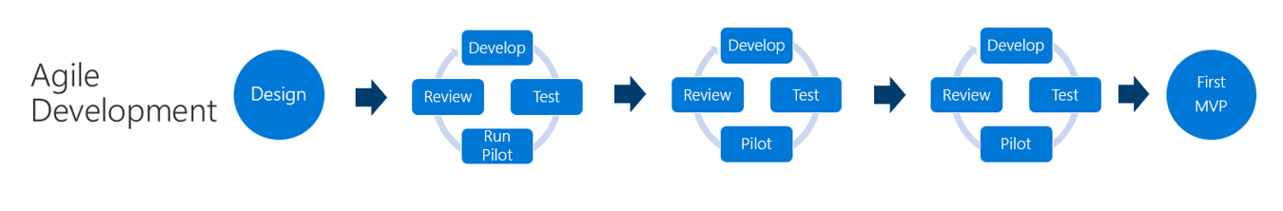
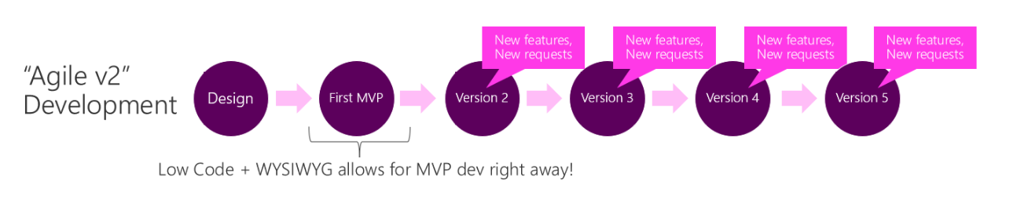
2. Development methodology – In both the waterfall and agile methodology of app development a significant amount of time can pass before the first minimum viable product (MVP) is delivered to users.
With, Power Apps, we can quickly create a usable version of our app, because it provides a WYSIWYG (what you see is what you get) development experience.

Slide 11

Planning a power app project
The basic phases of making an app are as follows:
Planning phase: Identify the who, what, when, and why.
Designing phase: Model the data (decide how the data you need and create will be organized, accessed, and stored) and sketch out the app screens.
Making phase: Create the app.
Testing phase: Have users try the app.
Deploying and Refining phase: Get your app into the hands of users, get feedback, and decide what to change or add.

Slide 12

Use Cases
Finance: Quickly develop accurate budgets, forecasts, and reports that show updates in real time by creating apps from Excel.
Sales and Marketing: Connect disparate systems to provide instant notifications and mobile access to product info and sales tools.
Human Resources: Improve employee experiences and help them stay connected with easy-to-use apps that track data and share information.
Operations: Transform auditing processes, modernize inventory management, and save on dispatch costs.
Frontline workers: Improve in-store customer service processes and customer experiences.

Slide 13

Customers using Power Apps
Professional Services Industries: Accenture, EY, Arvato etc.
Banking and capital Market Industries: AY, HSBC, EUROBANK, USBank, and Swedbank, etc.
Insurance Industries: AXA, Zurich, Nationwide, PROSEGUR, etc.
Healthcare Industries: SAT Health, VITA’s healthcare, Fraser health etc.
Consumer Goods Industries: MI, G &J Pepsi, Cocacola Africa, Wipro etc.
Automotive: Toyota, Jaguar Land Rover, POS Aviation etc.

Slide 14
Advantages:
45% decrease in app development costs for a composite organization.
Speed and ease of development.
140% ROI on premium power platform features over 3 years for a composite organization.
AI capabilities: Either use pre-build models or build and train new models.
Standard connectors provide extensibility and tighter integration.
Participation of both citizen developers as well as pro-developers.
Limitations:
Limited customization.
Low-code applications developed through power apps can’t be published on Google Play Store, Apple App Store, and Windows Store.
Restricted functionalities.

Slide 15

Future Scope
As per Gartner report, by 2026, low-code development tools will account for 75 percent of new application development.
Deliver apps embedded with AI to modernize legacy applications.
More business-driven automation and expedite digital transformation journey of businesses.
Organization’s focus on improving workplace productivity and accelerating professional development.

Slide 16
Thank You

